Slide 1






Detecting Spam Emails
Student Details
Name: V. DHARSHINI
NM Id: au61772111021
College Name: GOVERNMENT COLLEGE OF ENGINEERING, SALEM

Slide 2
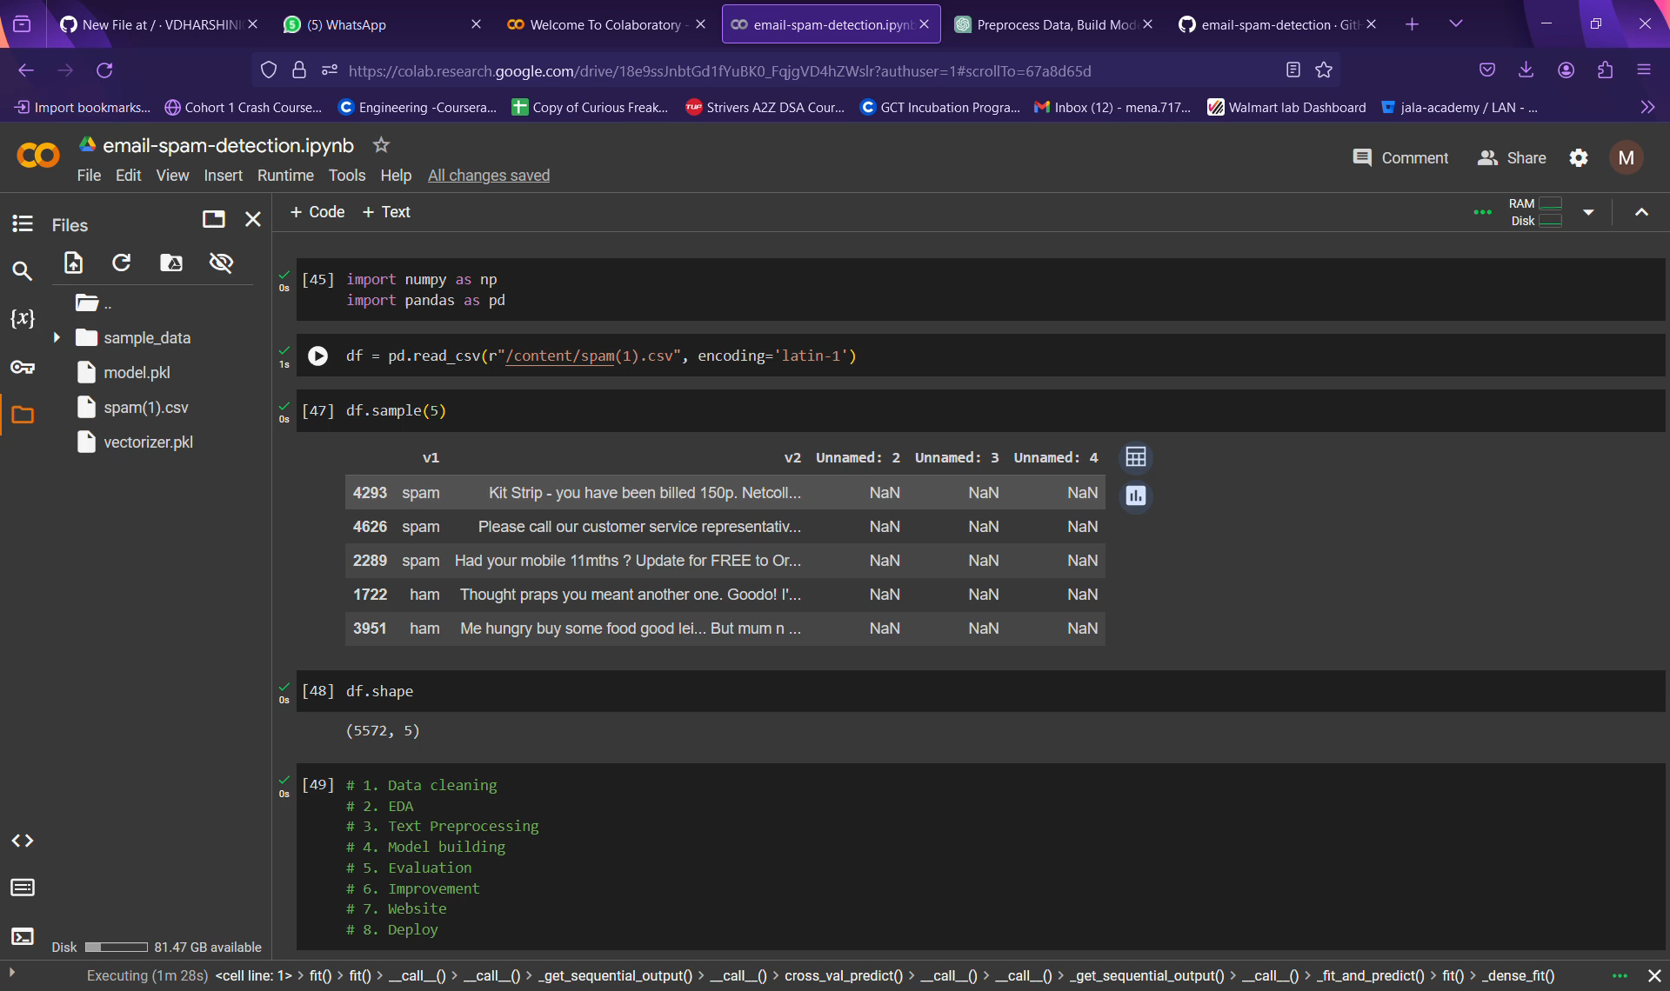
Output Demo Video
Notes:
2

Slide 3
Thank you!
Notes:
3

